Slide 1


Data in Memory
How data is stored in memory
Part 2 – Duration and Scope

Slide 2
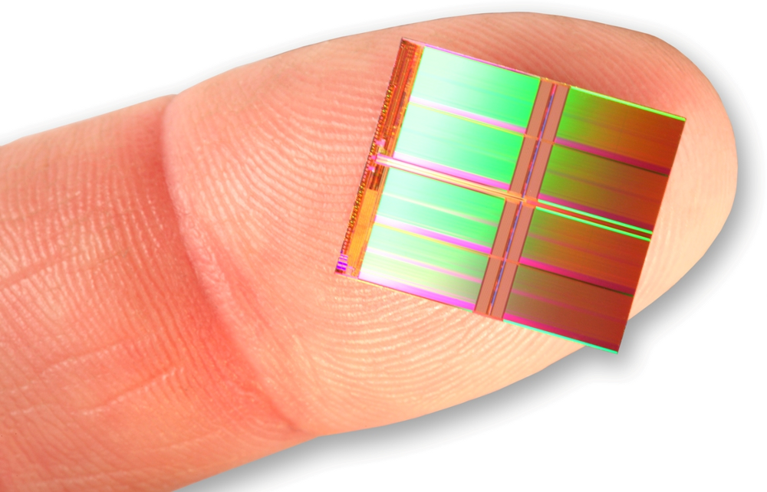
Storage Duration and Scope

Slide 3
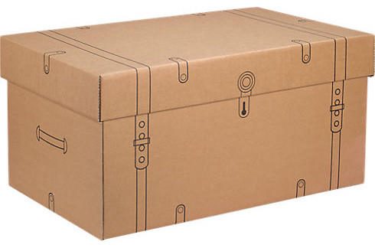
Linkage
C++ uses three different mechanisms to manage memory associated with data (differing in the method of allocation). Namely:
Static Storage
Dynamic Storage (heap)
Automatic Storage (stack)
The different forms of allocation help manage the varying lifespans of data (some temporary and short lived, others persisting across the entire execution).

Slide 4

Storage
Related to storage are the notions of scope and linkage.
Scope
Linkage
Defines the variables visible within the compiled file. Global scope: known throughout the file after the point of definition. Local scope: only known within the defining block.
Linkage defines how a name can be shared across different units (compiled files). External linkage: shared across units. Internal linkage: only within a single unit.
Notes:
Closely related to storage are the notions of scope and linkage.
Scope defines how widely visible a name is within a compiled file.
A variable with local scope is only known within the block in which it is defined.
A variable with global scope is known throughout the file after the point where it is defined.
Linkage defines how a name can be shared across different units (compiled files).
External linkage permits shared across units, whilst internal linkage permits sharing with functions within a single unit.

Slide 5

Function parameters and ordinary variables defined inside a function use automatic storage. They are called automatic variables (they come into existence when the function is called and expire when the function (block) terminates).
Automatic variables have local scope and no linkage (only visible within the defining function).
Automatic variables can be initialised with any expression that can be evaluated when the declaration is reached.
1 | void foo(int a) // a is an automatic variable
2 | {
3 | int b = 4; // b is an automatic variable
4 | }
Notes:
Function parameters and ordinary variables defined inside a function use automatic storage and are called automatic variables as they come into existence automatically when the function is called and expire when the function terminates (strictly block, see below).
Automatic variables have local scope and no linkage (i.e. they are only visible within the function in which they are defined and nowhere else).
Automatic variable can be initialised with any expression that can be evaluated when the declaration is reached.
void foo(int a) // a is an automatic variable
{
int b = 4; // b is an automatic variable
}

Slide 6

Automatic variables are allocated whenever execution enters the block containing the definition and expires whenever execution leaves that block (the variables enter local scope only after the point of declaration).
Aside: A block is a section of code enclosed between braces.
1 | void foo(int aVal) // aVal allocated
2 | {
3 | aVal = 0; // aVal now in scope
4 | { // bVal allocated
5 | aVal = 3;
6 | int bVal = 0; // bVal now in scope
7 | ...
8 | } // bVal expires
9 | ...
10 | } // aVal expires
Notes:
Automatic variables are allocated whenever program execution enters the block containing the definition and expires whenever execution leaves that block (the variables enter local scope only after the point of declaration).
Aside: A block is a section of code enclosed between braces.
void foo() // someVal allocated
{
int someVal = 0; // someVal scope begins
{ // someOtherVal allocated
someVal = 3;
int someOtherVal = 0; // someOtherVal scope begins
...
} // someOtherVal expires
...
} // someVal expires

Slide 7
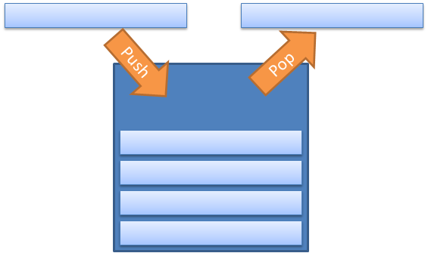
A means of easily managing automatic variable allocation/removal is required. This can be done using a stack (represented using base and top pointers).
When a function is called, automatic variables are added to the stack and the top pointer updated to the next free available address. When the function exits, the top pointer is reset to its previous value (freeing the allocated memory).
Notes:
Automatic Variables and the Stack
As automatic variables are allocated and expire as functions start and terminate a means of easily managing their allocation is required.
This is provided by a section of memory known as the stack. New automatic variables are pushed onto the stack when allocated and popped off when they expire.
Two pointers are used to manage the stack (one to the base of the stack, and one to the top of the stack). When a function is called the automatic variables are added to the stack and the top pointer updated to the next free available address. When the function exits, the top pointer is reset to the value it had before the function was called (freeing the allocated memory).

Slide 8
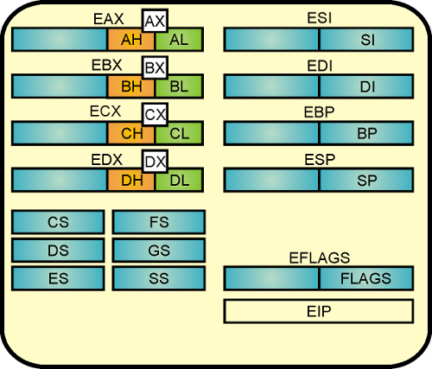
Aside: Register Variables
C++ defines a register keyword to request that the compiler use a CPU register to store an automatic variable
In C++11 this use is now deprecated (the compiler will automatically determine when variables are stored using registers).
1 | register int count;
2
Notes:
Aside: Register Variables
C defines a register keyword that was intended to suggest that the CPU use a register to store an automatic variable (using a register would provide faster access than memory).
register int counter;
In C++11 this use of register is being deprecated (the compiler will determine when variables are stored using registers).

Slide 9

Static variables exist for the complete duration of the program (a fixed block of memory is allocated upon program execution to hold all the static variables).
Static variables may be zero-initialized or undergo constant expression (both compile time) or dynamic initialization (runtime).
External Linkage (across files)
Internal Linkage (same file)
No Linkage (defining block)
Notes:
Static variables exist for the complete duration of the program (a fixed block of memory is allocated upon program execution to hold all the static variables).
Static variables can be defined with three different kinds of linkage:
external linkage (accessible across files),
internal linkage (accessible to functions within the defining file)
no linkage (accessible to just the defining function/block)
Static variables may be zero-initialized, they may undergo constant expression initialization, and they may undergo dynamic initialization. Zero and constant initialization occur at compile time, while dynamic initialization occurs at runtime.

Slide 10

External Linkage
External variables (also known as global variables) are defined outside of any function (hence the name). They have static storage duration and external scope.
The external variable can be used in any function that follows its definition.
1 | int someGlobal = 3;
2
3 | int main()
4 | { someGlobal++; }
Notes:
Static Duration, External Linkage
External variables (as known as global variables) are defined outside of any function (hence the name). They have static storage duration and file scope. The external variable can be used in any function that follows its definition.

Slide 11

External Linkage
The One Definition Rule
C++ enforces the “one definition rule” which states there can only be one definition of a variable.
However, an external variable must be declared in ever file it is used. This is done using the extern keyword (referencing declaration - no new storage is allocated).
Notes:
The One Definition Rule
C++ enforces the “one definition rule” which states there can only be one definition of a variable.
However, an external variable must be declared in each file that uses the variable. To permit this, C++ uses the keyword extern as a referencing declaration, i.e. it does not cause storage to be allocated because it refers to an existing variable.

Slide 12
External Linkage
Importantly: An extern value shared across multiple files can only be defined once (to preserve the one definition rule).
1 | // lib01.cpp
2 | int a; // External variable definition
3 | int b = 2; // External variable definition
4 | extern int c = 3; // Also external variable
5 | // definition due to initialization
1 | // file01.cpp
2 | extern int a; // Referencing declaration
3 | extern int b; // Referencing declaration
1 | // file02.cpp
2 | extern int b; // Referencing declaration
3 | extern int c; // Referencing declaration
Notes:
Importantly: An extern value shared across multiple files can only be defined once (to preserve the one definition rule).
// lib01.cpp
int a; // External variable definition
int b = 2; // Also external variable definition
extern int c = 3; // Also external variable definition due to initialization
// file01.cpp
extern int a; // Referencing declaration
extern int b; // Referencing declaration
// file02.cpp
extern int b; // Referencing declaration
extern int c; // Referencing declaration

Slide 13
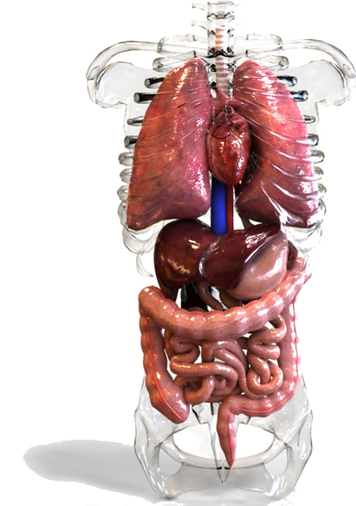


Internal Linkage
Applying the static modifier to a variable provides it with internal linkage (only visible within the containing file). This helps to avoid issues with the One Definition Rule, e.g.:
1 | // file01.cpp
2 | int var = 100; // External
1 | // file02.cpp
2 | int var = 100; // Also external
3 | void foo()
4 | { int a = var; } // Error
1 | // file02.cpp
2 | static int var = 100; // Internal definition
3 | void foo()
4 | { int a = var; } // OK – var ‘hides’ global
Notes:
Static Duration, Internal Linkage
Applying the static modifier to a variable provide it with internal linkage (only visible within the containing file). This helps to avoid issues with the One Definition Rule, e.g.:
// file1
int var = 100; // external declaration
// file2
int var = 5; // also external declaration
void foo()
{
int a = var; // error – var defined twice
Using internal linkage avoids this problem.
// file1
int var = 100; // external declaration
// file2
static int var = 5; // known to file2 only
void foo()
{
int a = var; // OK – uses file2 var, hides the file1 global var

Slide 14
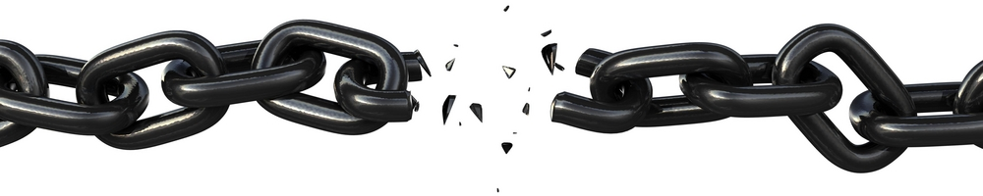
No Linkage
The static keyword can also be applied to variables defined inside a block. This means that the variable exists all the time but is only accessible within that block (i.e. a static local variable can preserve values between function calls).
It’s somewhat of a niche feature.
Notes:
Static Storage Duration, No Linkage
The static keyword can also be applied to variables defined inside a block. This means that the variable exists all the time but is only accessible within that block (i.e. a static local variable can preserve values between function calls).
It’s somewhat of a niche feature.

Slide 15

You might think that the different forms of linkage, etc. are a tad confusing and needlessly messy. You’d be right. More recent languages typically handle scope in a much cleaner manner.
Aside: Current C++ practice recommends the use of namespaces (explored later) as a means of better controlling scope.
Notes:
You might think that talk about different forms of linkage, global this and static is a tad confusing and needlessly messy. You’d be right. More recent programming languages generally handle scope, etc. in a much cleaner manner.
Aside: More recent C++ recommends that you use the unnamed namespace (explored later) as a means of making a name local to the compiled file.

Slide 16

In C++ the programmer can allocate/deallocate memory (variables, arrays, etc.) on demand (via the new and delete operators). Variables allocated in this way live on the heap (free store).
The new and delete operators must deal with more complex memory management (compared to stack management) as creating/deleting objects can leave ‘gaps’ in the free store that need to be either removed or tracked/reused.
Notes:
Dynamic Storage
In C++ the programmer can allocate/deallocate memory (variables, arrays, etc.) on demand using the new and delete operators. Variables allocated in this way live on the heap (a.k.a, free store).
The lifetime of dynamically allocated data is determined by the programmer (unlike static or automatic variables).
Unlike the stack (where memory management was very simple) the new and delete operators must deal with a more complex situation (creating and deleting multiple objects can leave ‘gaps’ in the free store that need to be either removed or tracked/reused).

Slide 17

The lifetime of dynamically allocated data is controlled by the programmer. Memory leaks occur when the programmer creates some new data item on the free store but ‘forgets’ to remove it.
1 | void foo()
2 | {
3 | int *data = new int[10];
4 | // process data
5 | } // opps, data not released.
Over time, memory leaks can consume all the memory available to the application, causing a crash with an out-of-memory error. We will return to dynamic allocation when we consider pointers.
Notes:
The lifetime of dynamically allocated data is determined by the programmer (unlike static or automatic variables). Memory leaks occur when the programmer creates some new data item on the free store but ‘forgets’ to remove it, for example:
void foo()
{
int *data = new int[10];
// process data here
} // opps, data not released – it’s still stored on the heap
Over time memory leaks can consume all the memory available to the application, causing a crash with an out-of-memory error.
Advice: Any time you use the new keyword ideally introduce a corresponding delete. Smart pointers can help automate the task.
Aside: We will return to dynamic allocation after exploring basic pointers in C++

Slide 18

Key takeaways:
Understanding how your data is stored and arranged in memory is key to writing efficient programs.
In C++ this comes down to understanding heap and stack storage alongside variable scope and linkage.
Your understanding of how data is stored will be important when we explore dynamic memory allocation and pointers in C++.

